Slide 1

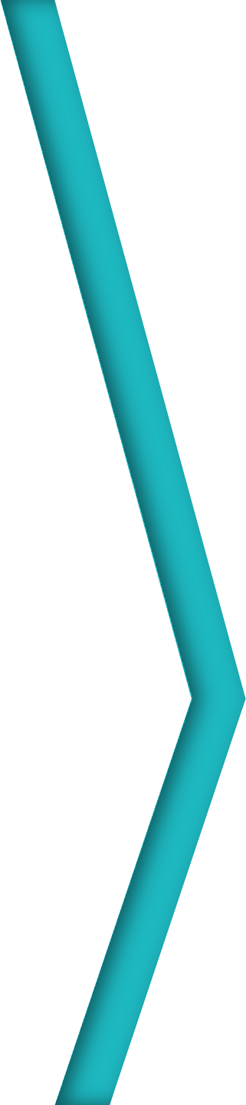

Session 12
ASP.NET MVC
Razor, Security, and Other Features
For Aptech Centre Use Only

Slide 2
Session Overview
List the differences between Razor and ASPX
Define Razor in ASP.NET MVC
Explain the various security options in MVC
Explain how to create a partial view
Describe data access layers
For Aptech Centre Use Only

Slide 3
Introduction to Razor
Razor is a popular view-engine or a markup language used at the server-side.
Razor Syntax
Both HTML and server-side code are employed for writing Razor syntax.
For Aptech Centre Use Only
File extensions in the Razor view are .vbhtml for VB and
.cshtml for C#.
ASP.NET
Razor Syntax is Compact, Easy to Learn and supports IntelliSense.
.NET Framework
In Visual Studio 2017 with ASP.NET MVC, Razor view engine is built-in by default.

Slide 4
Rules of Razor Syntax for C#
Use @{ ... } for Razor code blocks.
Start inline expressions (variables and functions) with @.
Use semicolon for ending code statements.
For Aptech Centre Use Only
Templ ate
Use var keyword to declare variables.
Data
Output
Use quotation marks to enclose strings.
Adhere to case sensitivity of C# code. Use .cshtml extension for C# files.

Slide 5
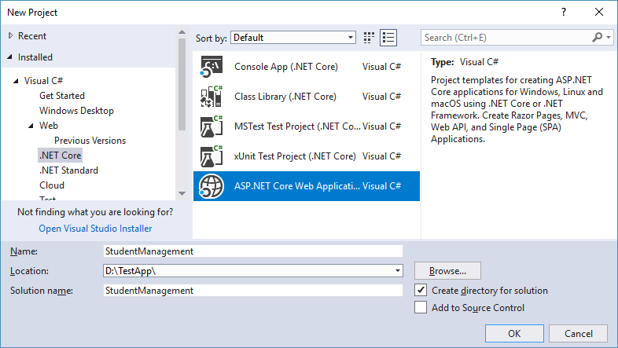
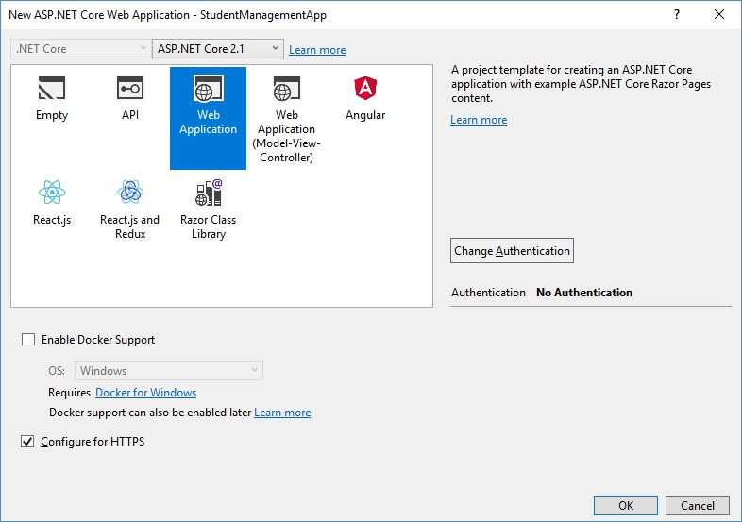
Creating a Razor Application (1-4)
For Aptech Centre Use Only
Creating a New ASP.NET Core Application
Select Project Template

Slide 6
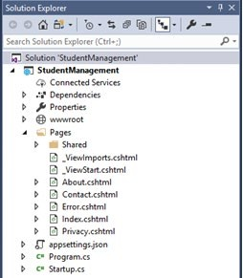
Creating a Razor Application (2-4)
The application is created with default folder structure as shown in Figure.
For Aptech Centre Use Only
Directory Structure

Slide 7
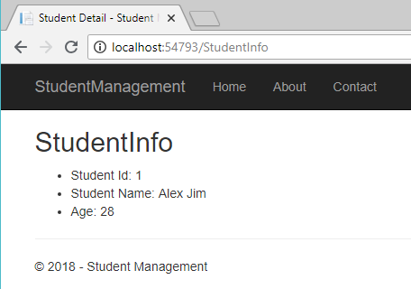
Creating a Razor Application (3-4)
For Aptech Centre Use Only
Output of Using model Object

Slide 8
Creating a Razor Application (4-4)
Razor Command
Description
@if
Marks the beginning of the if condition.
@using
Allows using the different packages, namespaces, and classes.
For Aptech Centre Use Only
@try, catch, finally
Are used for exception handing.
@inherits
Gives full control over the inherited class.
Razor Commands

Slide 9
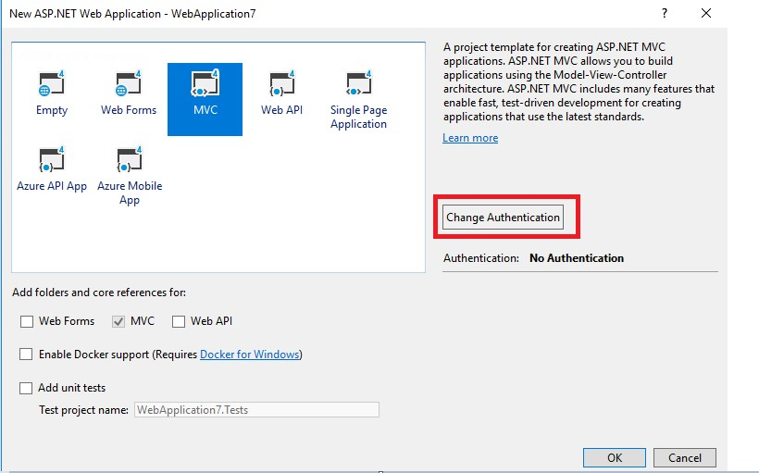
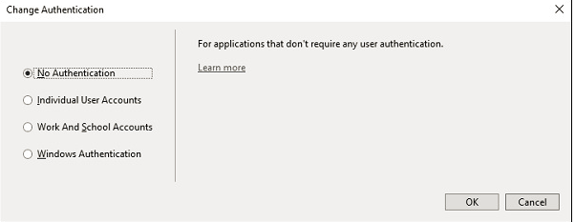
ASP.NET MVC Security
No Authentication
Used to build a Website that does not give importance to who the visitors are.
Individual User Accounts
Use this option for establishing the identity of the user in an Internet site.
For Aptech Centre Use Only
Work and School Accounts
Use this option for business applications, which employ active directory federation services.
Change Authentication Button
Windows Authentication
It enables the user to launch a browser to the application within the same firewall after logging in to Windows.
Change Authentication Window

Slide 10
Partial Views in MVC
Partial view is an exclusive view capable of rendering a portion of the view content.
Code duplication can be reduced using this view as it can be reused in multiple views.
The ViewDataDictionary object is used to instantiate the partial view.
For Aptech Centre Use Only
 | The data of the parent view does not get affected even if there is any change in the
 | data.
 | To render any related data in a partial view, which is part of the model, ensure to
 | use the RenderPartial method.

Slide 11
Creating Partial Views in MVC
Right-click View and select Shared folder.
1
Select Add →View. Click the Create as a partial view check box. Name the view as TestView. Add some markup in the view.
2
For Aptech Centre Use Only

Slide 12
Differences between View and Partial Views
View | Partial View
It includes a layout page. | It does not include a layout page and lightweight.
It renders viewstart page before rendering any view. | It does not look for viewstart.cshtml. Within the _viewstart.cshtml page, no common code for a partial view can be placed.
It includes markup tags, such as HTML, body, head, title, meta, and so on. | It does not contain any markup as it renders within the view.
Differences Between View and Partial View
For Aptech Centre Use Only

Slide 13
Data-Layer Project Referenced from MVC and Razor Page Applications
When software components are grouped based on their purpose, they form a layered architecture.
Layered architecture is mainly used for creating an enterprise- reusable domain model.
These distributed design applications are scalable, extensible, maintainable, and highly adaptable.
Developers can implement Data Access Layer as a separate Class Library and reference it in the MVC Project.
For Aptech Centre Use Only

Slide 14
Summary
Razor is a markup language used at the server-side. It uses a markup syntax to embed into Web pages a server-based code, such as Visual Basic and C#.
Razor supports both C# and VB. It is compact, easy to learn, and IntelliSense.
HTML content and Razor code are the two types of content that are seen on a Razor Web page.
Server-side code is written along with HTML code starting with @ symbol.
Verifying the identity of a user is called authentication.
Partial view is an exclusive view capable of rendering a portion of the view content.
Data access layer can be created as a separate class library and referenced into an ASP.NET MVC application.
For Aptech Centre Use Only

